Slide 1

Real Estate Market Predictive Analysis in the Philippines
Elloso, Lance Asher M.

Slide 2

Problem Statement
The inconsistent nature of house price fluctuations makes it difficult for individuals and entities to make informed decisions regarding property transactions.
Notes:
A dynamic initiative aimed at transforming the way we comprehend and predict house prices in the Philippines.

Slide 3
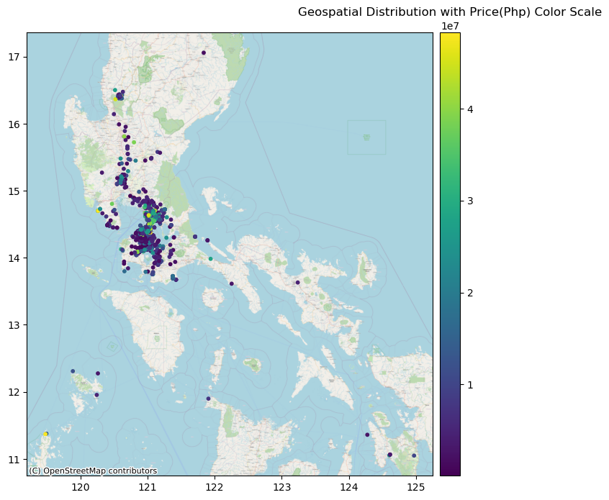
Solution: Market Analysis + Advanced Predictive Models
Solution? Advanced predictive models - Random Forest Regression and XGBoost! These models provide stakeholders in the local housing market with an additional tool for making well-informed decisions.

Slide 4
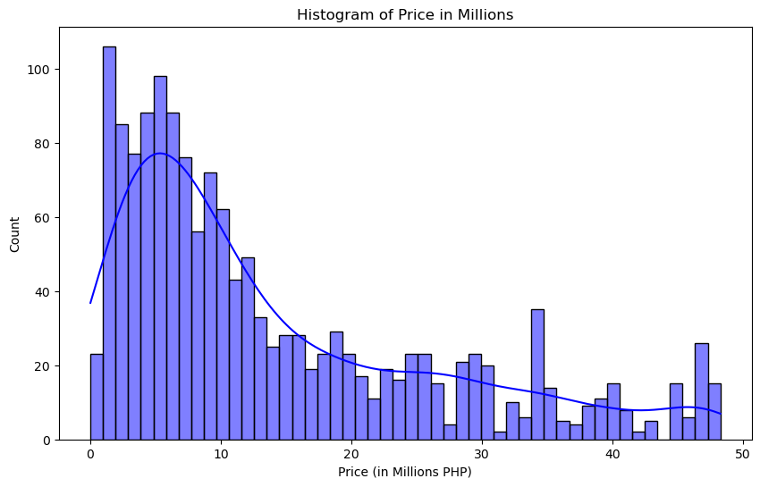
Price Distribution
The distribution of property prices. Understanding this dynamic landscape is crucial for navigating the diverse real estate market in the Philippines.
Visualizing the Distribution: A graphical representation of the spread of property prices.
Price Ranges: Identifying clusters and trends within different price ranges.
Market Dynamics: Insights into the diversity and range of property values.

Slide 5
Key Influencers
Random Forest Regression Insights:
Land Size: A foundational factor in predicting property values.
Building Size: The physical structure that significantly impacts pricing.
Category 'Land': The property category influencing pricing dynamics.
XGBoost:
Category 'Land': Maintaining its importance across models.
Category 'Commercial': A key category impacting property prices.
Building Size: Continues to play a crucial role in valuation.
Notes:
Understanding these key features is the key to making strategic decisions in the dynamic real estate market of the Philippines.

Slide 6
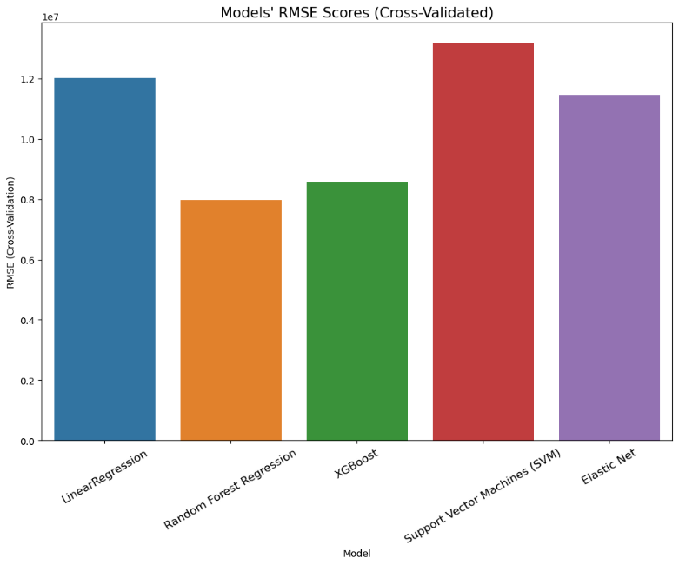
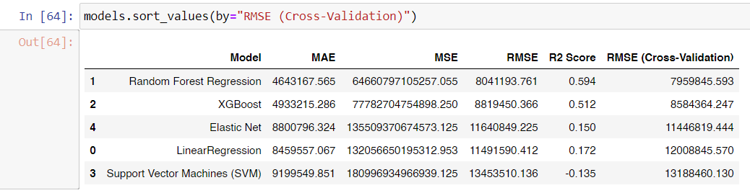
Accomplishment: R2 Scores & Model Performance
Both models achieved R2 scores just beyond 0.50, showcasing their efficacy in capturing the complexities of the market. A significant leap in real estate analysis within the Philippines!

Slide 7

Insight: The Pivotal Role of Data
The pivotal role of data is apparent. For future endeavors, we recommend enhancing data collection, incorporating timestamps for continuous monitoring of housing price trends.

Slide 8

Future Vision: Application of Advanced Analytical Techniques
This approach enables the application of more advanced analytical techniques, improving the efficacy of machine learning models and resulting in enhanced outcomes.

